Slide 1
Web App Development with AI
HTML5/XHTML
Introduction to forms

Slide 2
XHTML Forms
Many online activities require forms e.g. online purchases
Sending the information collected via a form to a Web server is easy and automatic
the data collected via the form is bundled (encoded) by the browser into what is known as name-value pairs, according to the Common Gateway Interface (CGI) format.
A form has two distinct parts: the front-end and the back-end.
the front-end is the form itself in the Web page; the surfer can see it and interact with it (fill in fields, click buttons etc…)
the back-end is not visible to surfers and they do not interact with it at all; this is the computer program sitting on the Web server that processes the form the surfer submitted.
We are concerned with the front-end (CGI relates to the server end (i.e. the back end)).

Slide 3
XHTML Forms
How does the front-end form and the back-end computer program that processes the form, recognise each other?
by means of the <form> tag; this tag has an action attribute that specifies the name of the program that handles the form’s input and where it resides on the server
The form tag is a container tag for the form i.e. you place all the other elements inside it:
<form>
<!-- put your form here -->
</form>
The elements are added to the form in the order they are specified in your XHTML file

Slide 4
<form> attributes
method
specifies the way the browser sends the name-value pairs to the Web server; (we will use post always)
action
specifies the name and location of the computer program that processes the form’s data;
can be a computer program, an email address to which the forms data should be sent or any other protocol such as that for opening a file in which the data is to be placed
Example:
<form method=“post” action=“mailto:jbloggs@tus.ie”>

Slide 5
Form <input>
<input> tag - creates form elements e.g.
text field
Text area
Password field
checkboxes
radio buttons
submit/reset buttons
Example (text field):
<input type=“text” name=“surname” value=“enter surname” maxlength=“20” />
http://www.w3schools.com/tags/tag_form.asp

Slide 6
<input> attributes
name
specifies the name of the form element; used by the browser to create name-value pairs before sending them to the Web server
value
specifies the initial value of the form element (the default value)
type
specifies the type of form element to create e.g. text, checkbox, radio, submit and reset.
size
the visible length of a text field
maxlength
the maximum number of characters the user can enter
checked
used only with checkboxes and radio buttons (boolean on or off)

Slide 7
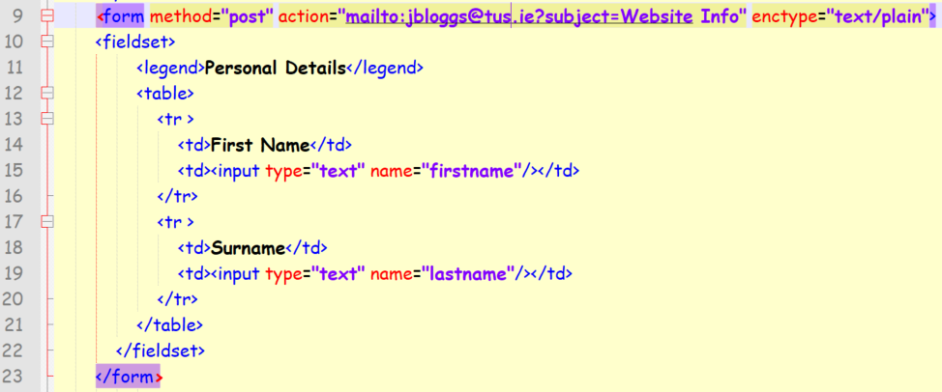
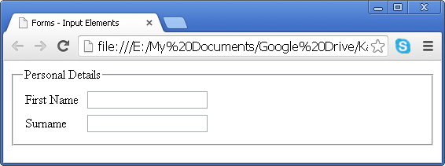
Input elements – textfield Table Structure

Slide 8
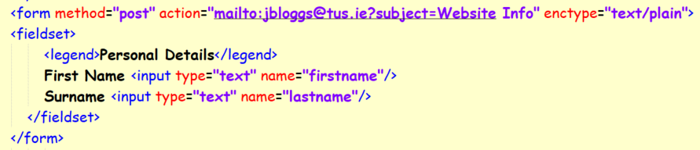
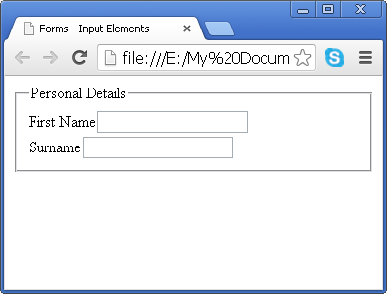
Input elements – textfield No Tables

Slide 10
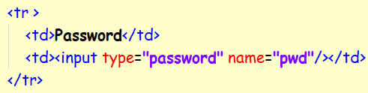
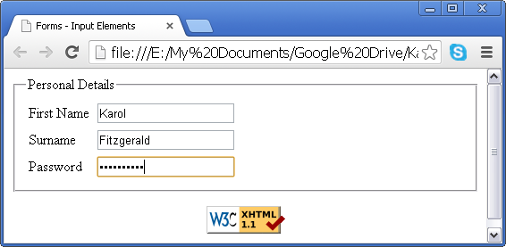
Input elements – password field

Slide 11
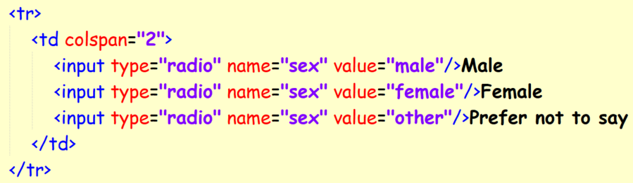
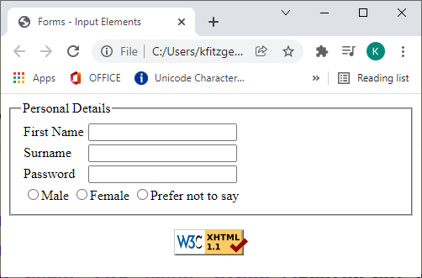
Radio Buttons

Slide 12
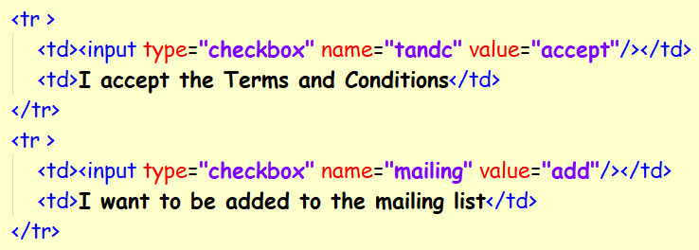
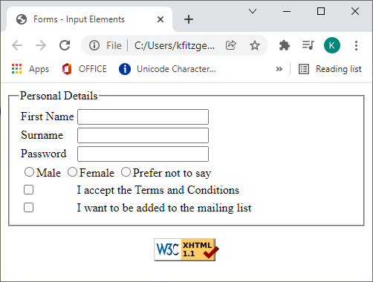
Checkboxes

Slide 13
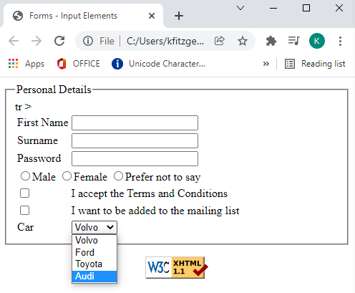
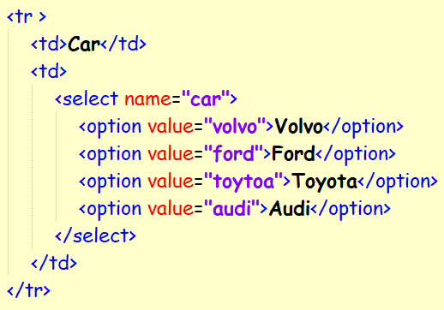
Selection Box

Slide 14
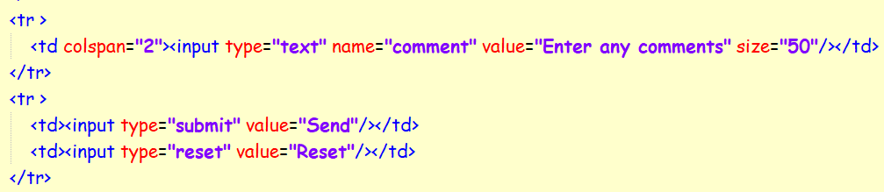
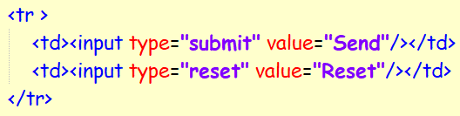
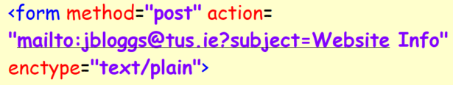
Sending an email from a form

Slide 15
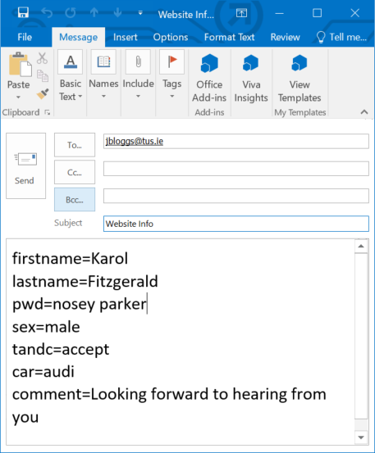
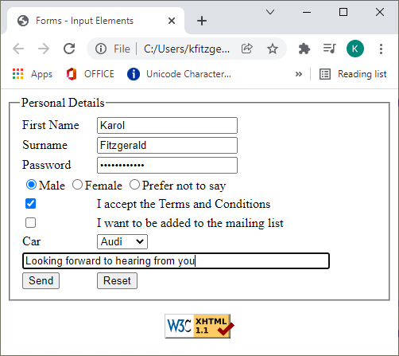
Sending email from form

Slide 16
Exercise
Download the W3CSS_Root folder from Moodle
Download the TUS_Logo.png file and place it in the images folder
Create an XHTML document called membership_form.html
Design a form to allow someone join as a member of your website.
The form must be XHTML1.1 validated and must use all components detailed during this lecture.
Use the contents of the next slide as a guide.
The form must have the following subsections:
Personal
Login Details
Course Detail
Mailing lists
Comments
Submit Information
By default the subject of this form must be Web Site Info and the encryption type must be text/plain
Use the output as shown in slide 19 as a guide when you test your code. Use the TUS logo provided on Moodle
Use W3-CSS to style your page.

Slide 17
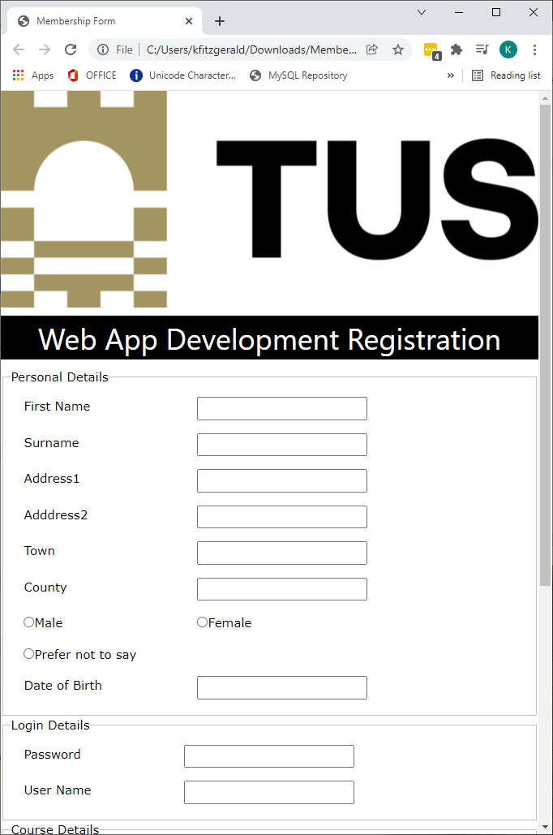
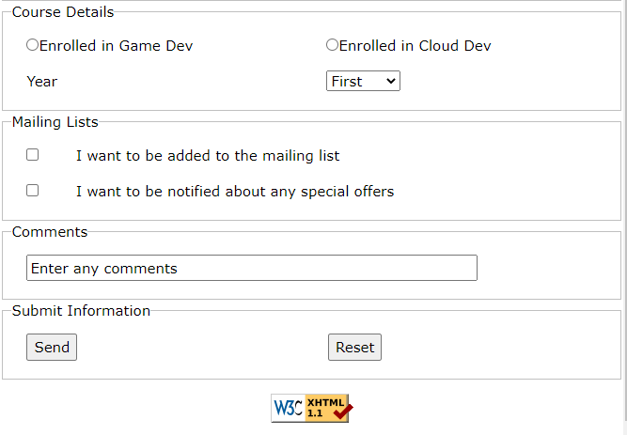

Slide 18
